Slide 1
Food Safety in Chicago
Ali Alhakam
DAB-11

Slide 2
Introduction
Food is essential to health and the community, but unsafe food is a major global issue. According to the World Health Organization (WHO) 1 in 10 people fall ill each year, that’s around 600 million annually. And over 420,000 die from contaminated food.
This analysis focuses on the City of Chicago, which has more than 16,000 food establishments, hence food safety is critical. The analysis will use inspection data from 2010 to the present to uncover patterns in compliance, violations and risk.

Slide 3
Problem Statement
Since 2010 to the present, the Chicago Department of Public Health(CDPH) has inspected thousands of food establishments, 75% of which are considered high-risk. However, about 59% of those pass their inspections. This persistent failure rate poses a serious risk to public health and suggests the need for better understanding of the factors that contribute to these outcomes.

Slide 4
Goal and Objectives
The goal is to analyze inspection results, violation types, location, and establishments to identify the most common factors or trends linked to inspection failures and to improve the risk and result of the inspections.
Objectives:
What are the trends in inspection outcomes over time?
How do different types of food establishments compare in compliance?
Which high-risk establishments are repeatedly failing, and how can they be supported?
Which violations are most strongly associated with failure?
Where are the highest concentrations of failed inspections geographically?

Slide 5
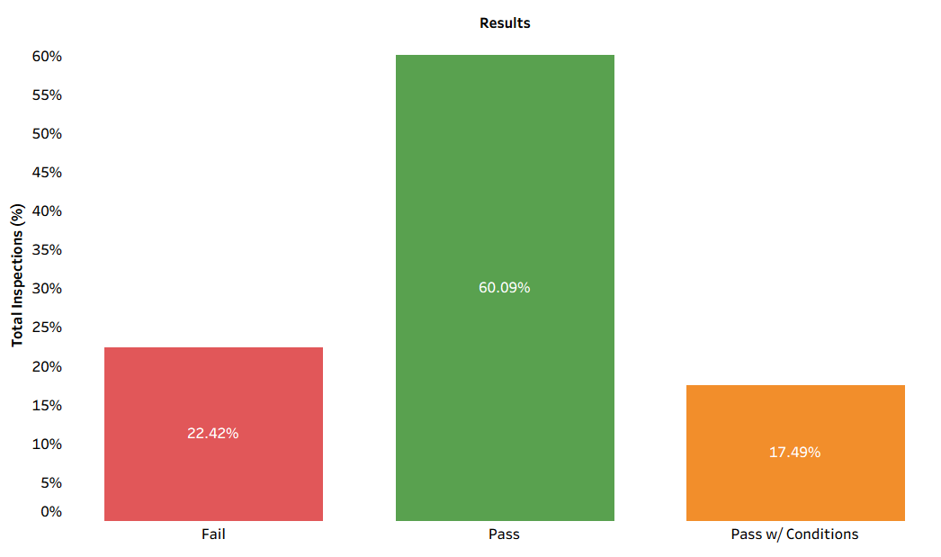
Inspection Results Overview

Slide 6
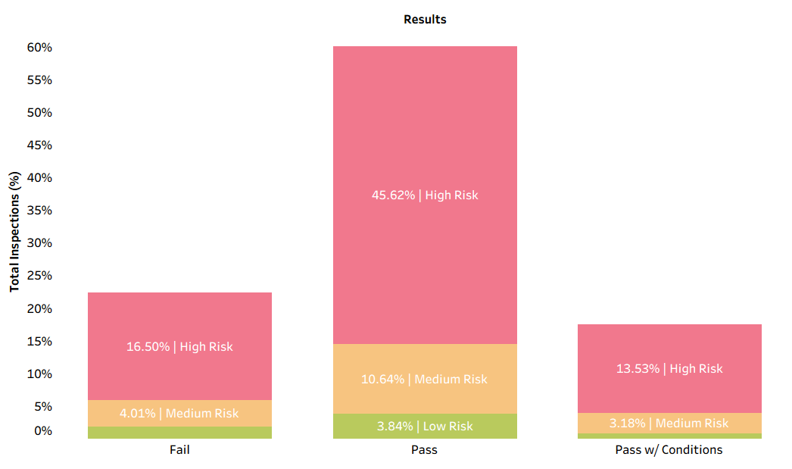
Inspection Results Overview (by Risk)

Slide 7
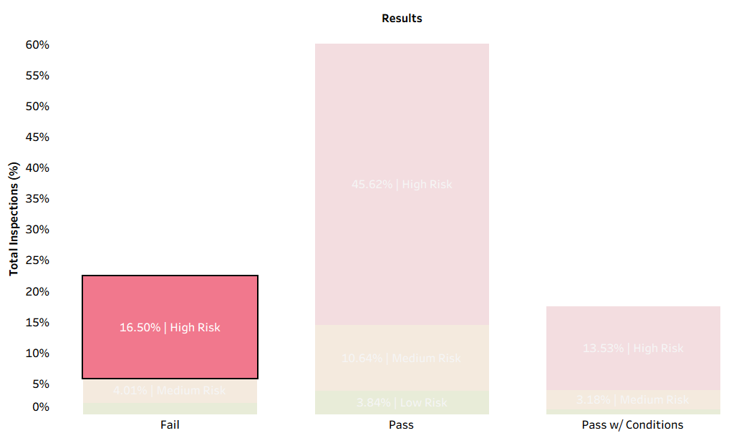
Inspection Results Overview (by Risk)

Slide 8
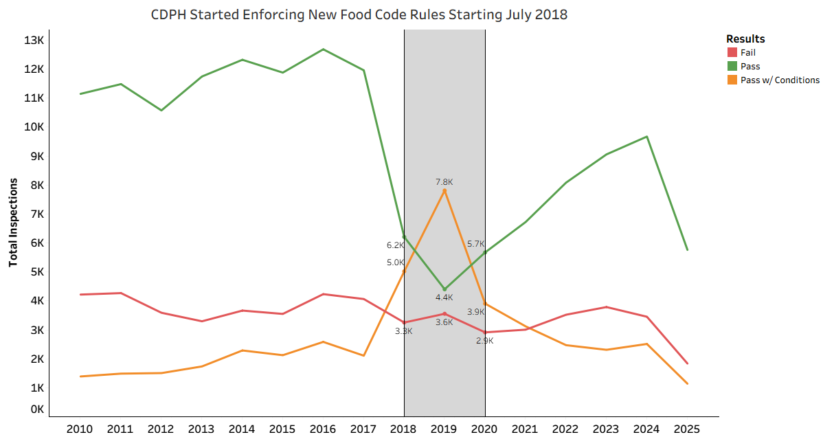
Inspection Seasonal Trends
2010–2017: Most places either passed or failed. “Pass with Conditions” was small.
2018–2019: Big rise in conditional passes due to new policy, peaking in 2019. Passes dropped, failures dipped.
2020–2024: Inspections volume fell during COVID, then partially recovered. Passes rose, failures stayed constant.

Slide 9
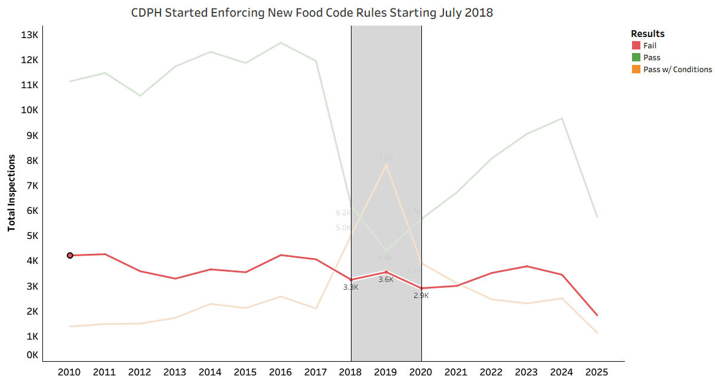
Inspection Seasonal Trends
2010–2017: Most places either passed or failed. “Pass with Conditions” was small.
2018–2019: Big rise in conditional passes due to new policy, peaking in 2019. Passes dropped, failures dipped.
2020–2024: Inspections volume fell during COVID, then partially recovered. Passes rose, failures stayed constant.

Slide 10
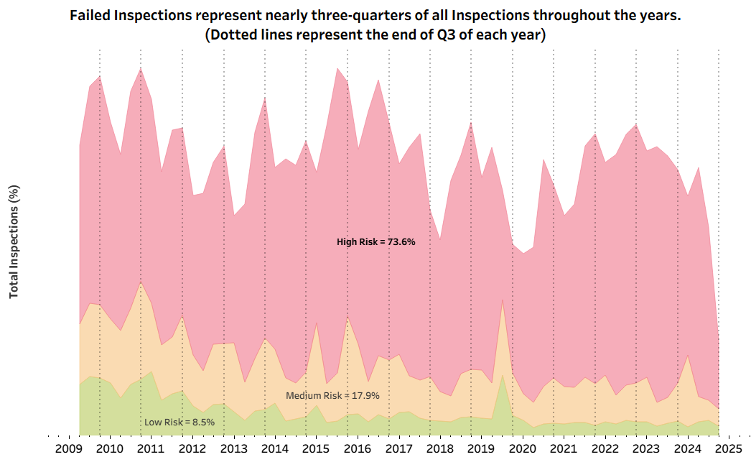
Failed Inspections Overtime by Risk

Slide 11
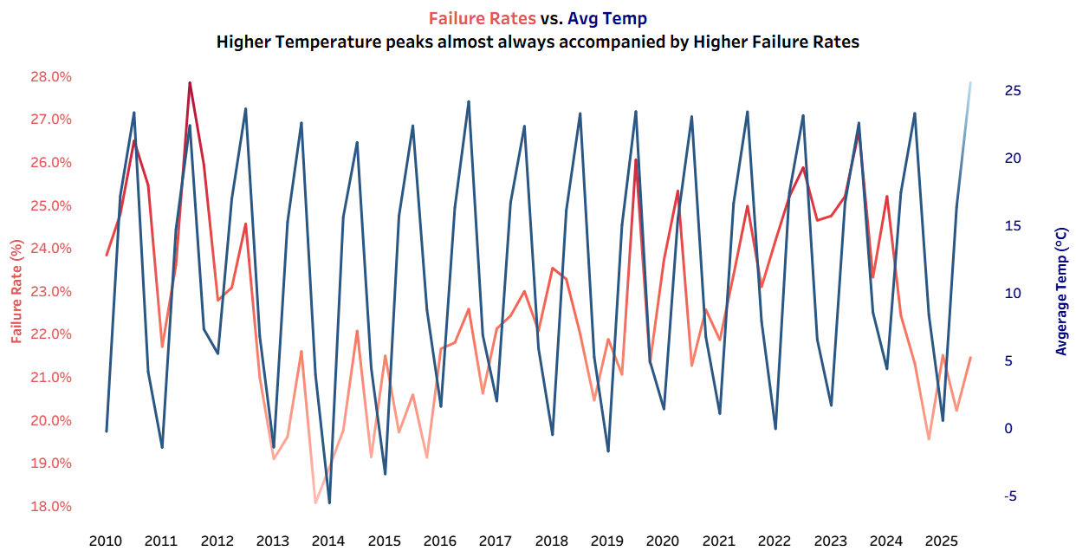
Seasonality Link: Hotter Quarters Higher Failures

Slide 12
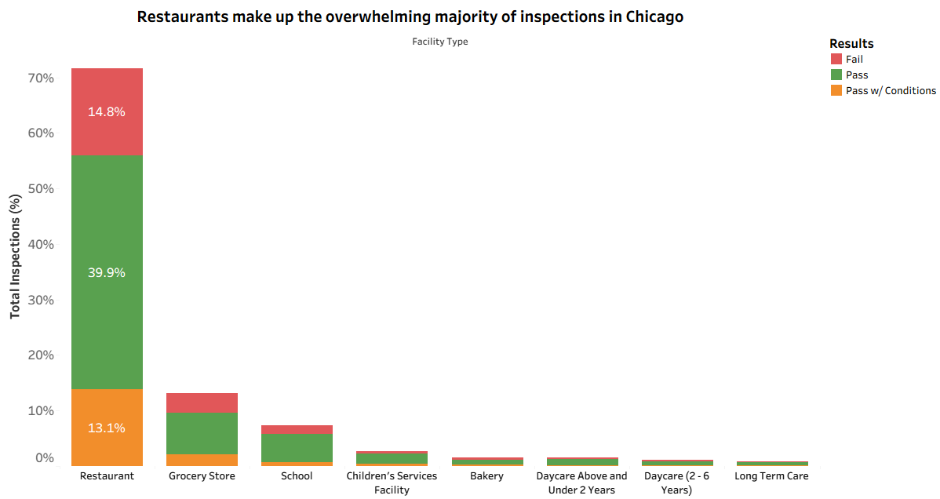
Inspection Outcomes by Establishment
Restaurants dominate: Over 170K inspections, totalling about 70% of inspections.
Grocery stores & schools: Grocery stores show a mix of outcomes, while schools mostly pass but failures remain concerning.
Smaller facilities matter: Daycares and long-term care centres have fewer inspections, but failures pose high risk to vulnerable groups (children & elderly).

Slide 13
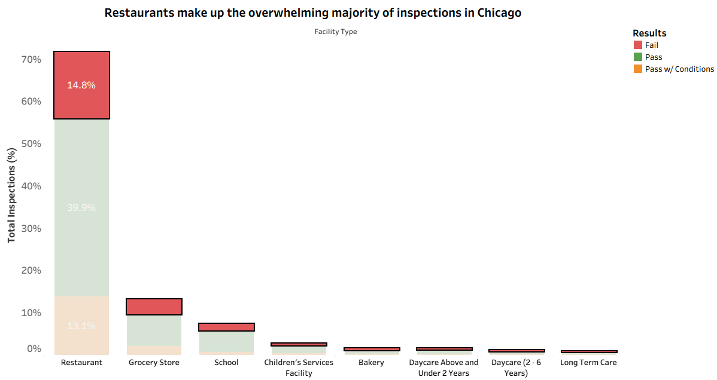
Inspection Outcomes by Establishment
Restaurants dominate: Over 170K inspections, totalling about 70% of inspections.
Grocery stores & schools: Grocery stores show a mix of outcomes, while schools mostly pass but failures remain concerning.
Smaller facilities matter: Daycares and long-term care centres have fewer inspections, but failures pose high risk to vulnerable groups (children & elderly).

Slide 14
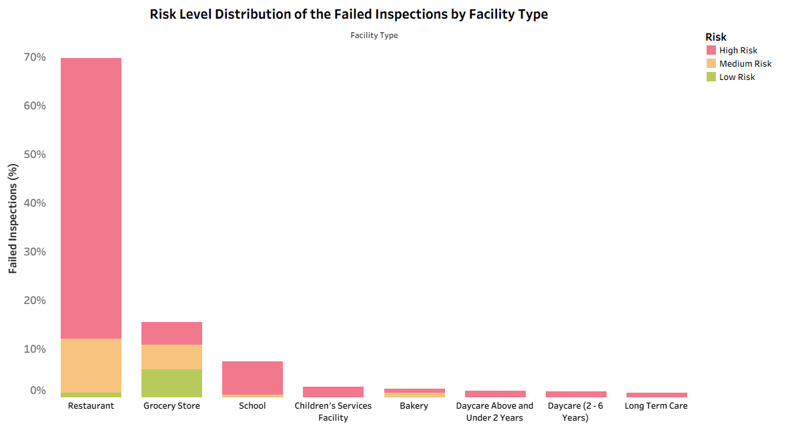
Inspection Outcomes by Establishment (by Risk Levels)
Restaurants dominate high-risk failures: The overwhelming majority of high-risk inspection failures come from restaurants, far more than any other facility type.
Schools are the next concern: Although smaller in total, nearly all failures in schools fall under high-risk, which is especially critical since they serve children.
Other sensitive facilities: Daycares and long-term care facilities show smaller counts, but when they fail, it is almost entirely high-risk, making them priority targets for public health monitoring.

Slide 15
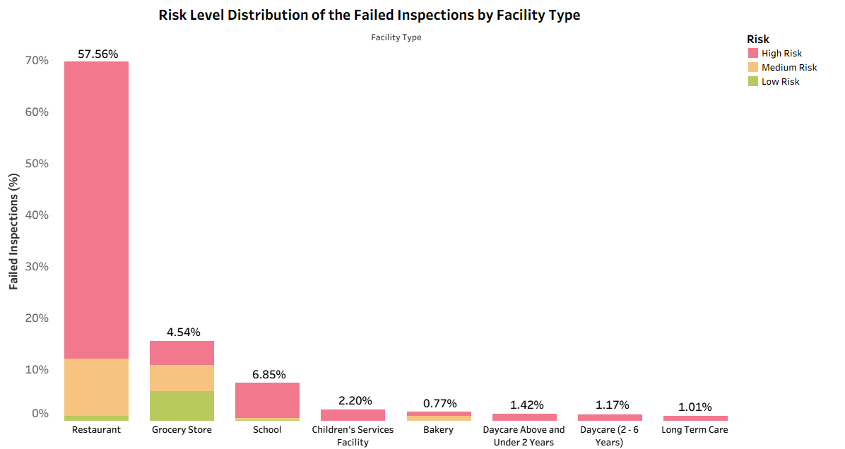
Inspection Outcomes by Establishment (by Risk Levels)
Restaurants dominate high-risk failures: The overwhelming majority of high-risk inspection failures come from restaurants, far more than any other facility type.
Schools are the next concern: Although smaller in total, nearly all failures in schools fall under high-risk, which is especially critical since they serve children.
Other sensitive facilities: Daycares and long-term care facilities show smaller counts, but when they fail, it is almost entirely high-risk, making them priority targets for public health monitoring.

Slide 16
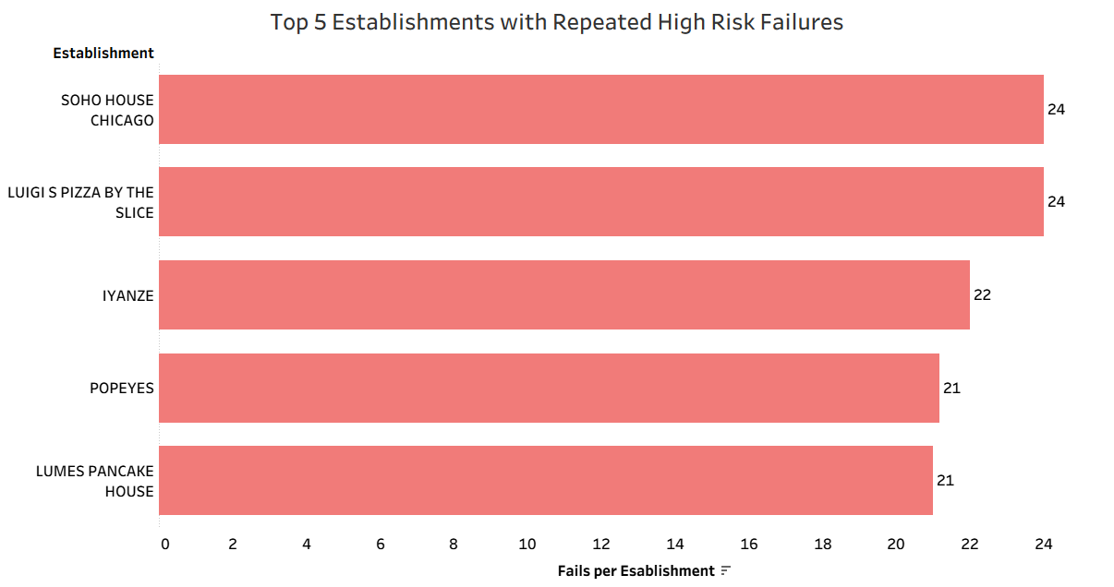
Chronic High-Risk Failures: Who Fails the Most?
Repeat offenders: Soho House & Luigi’s Pizza average 24 failures per site, showing chronic issues.
Not just big chains: Small or single-site places (Iyanze, Lumes) also rank high.
Across types: Problems span major chains, pizza, ethnic dining, and diners.
Popeyes exception: Only major chain in top 5, with 21 fails per site, higher than most other national brands.

Slide 17
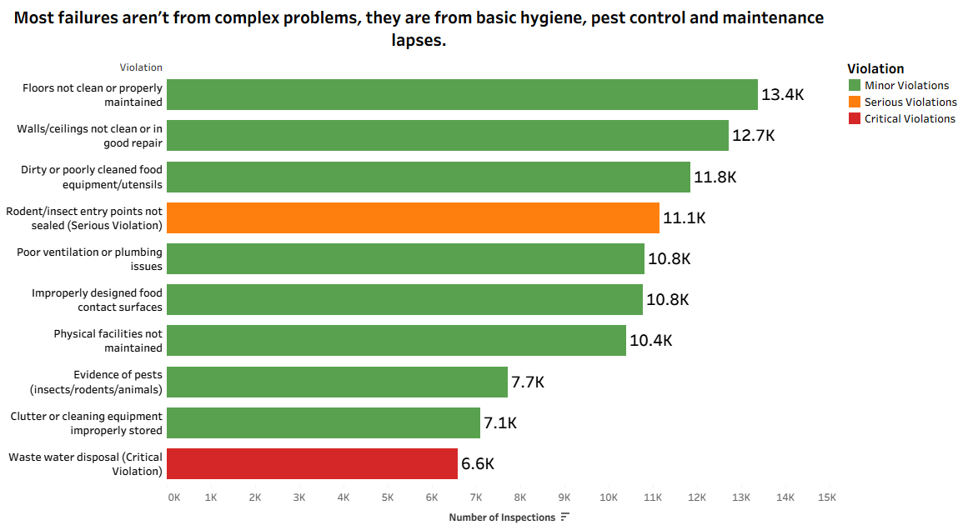
Key Drivers of Food Inspection Failures
Basic hygiene lapses like unclean floors, walls, and food equipment are the leading causes of failure.
Pest control issues remain a major challenge, with unsealed entry points and evidence of infestations.
Facility maintenance problems (ventilation, plumbing, upkeep) also contribute significantly to the failure rate.
Critical risks such as wastewater disposal, while less common, pose severe health hazards.

Slide 18
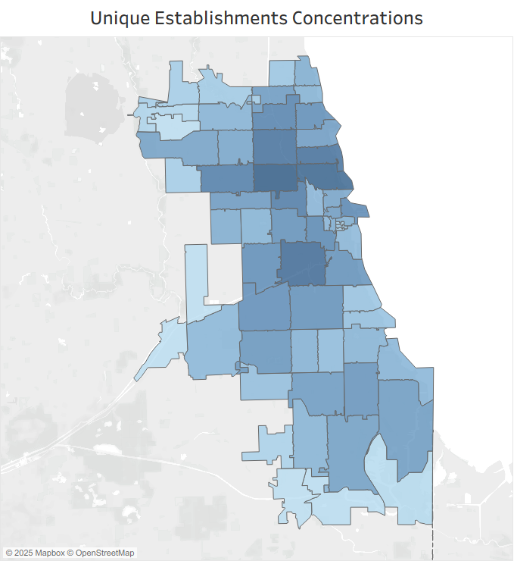
Where Establishments Cluster Across Chicago
Downtown & North Side: Highest concentration of establishments, reflecting dense dining hubs. This reflects the clustering of restaurants, bars, and high-traffic dining areas in central and northern Chicago.
South & West Sides: Moderate density, still key community centres, suggests fewer establishments compared to the downtown area up north.
City edges: Sparse, more residential/industrial.
Implication: Prioritize inspections in dense ZIP areas; use outreach programs for low-density areas.

Slide 19
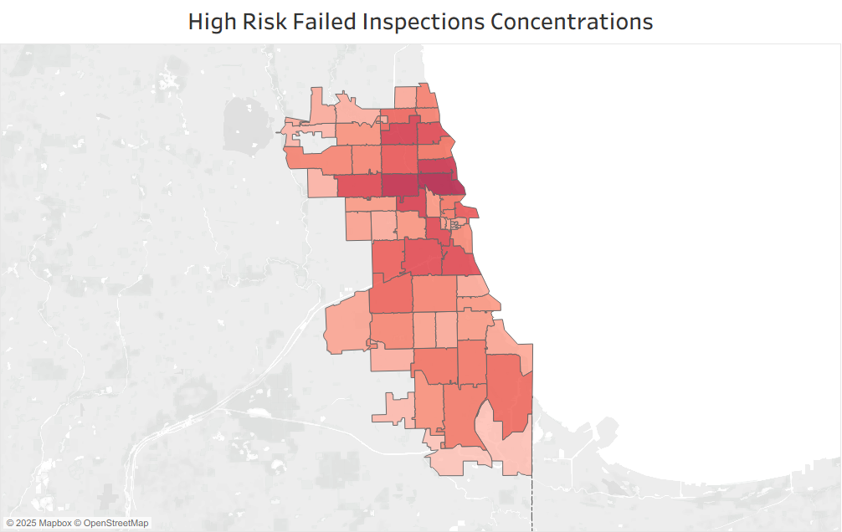
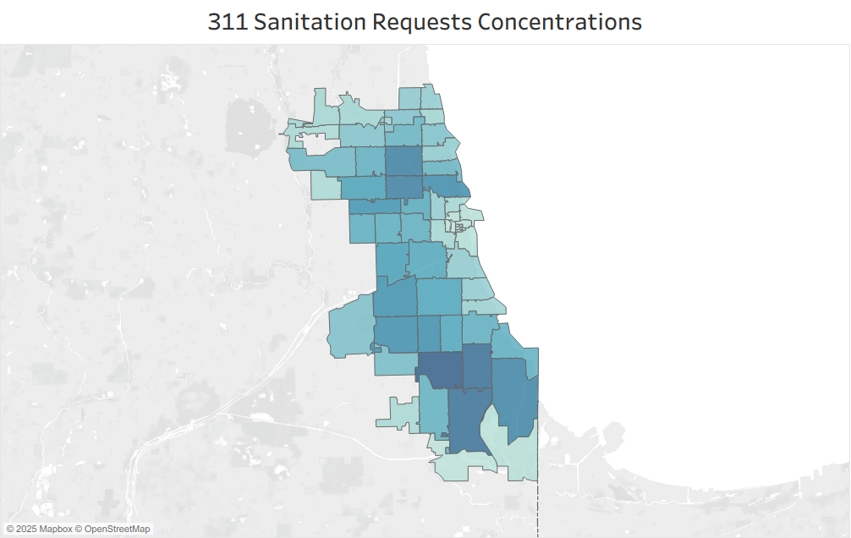
Comparing High-Risk Inspections & Community Sanitation Requests

Slide 20
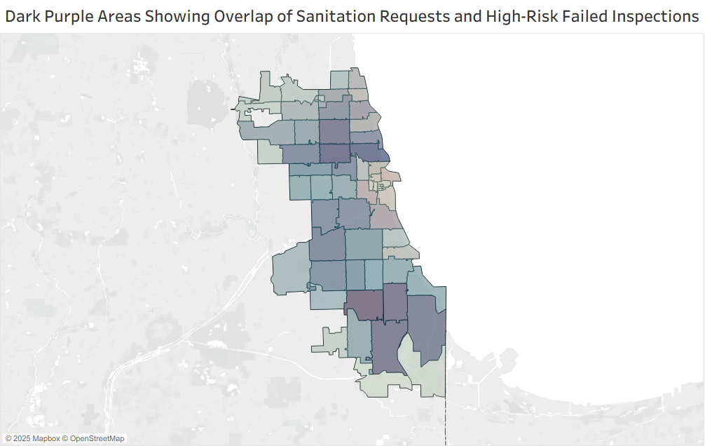
Overlapping Hotspots: When Sanitation Issues & Food Failure Aligns
Hotspots: Dark purple shows areas where 311 sanitation issues and high-risk inspection failures overlap.
Systemic risk: Community sanitation problems possibly drive food establishment failures.
Instead of only focusing on restaurant issues (e.g., inspections, citations), the city should also address neighbourhood-level sanitation issues (trash collection, pest control, waste disposal).

Slide 21
Recommendations
Target High-Risk Facilities & Core Violations
Focus inspections and awareness on High-Risk establishments and the violations most linked to failure: sanitation(floors/walls), equipment upkeep and pest control.
Adapt to Seasonal & Environmental Risks
Provide seasonal guidance and training (temperature control, storage, pest prevention) to businesses in preparation for Q3 (Summer) seasonal peaks.
Geographic Coordinated Programs
Prioritize locations where inspection failures overlap with sanitation issues by combining targeted inspections, pest control and waste management outreach programs in the locations with the highest density too help more establishments.
Protect Sensitive & Underrepresented Establishments
Schools, daycares and long-term care centers serve vulnerable populations. Even with fewer inspections, maintaining strict oversight and tailored training is highly recommended.

Slide 22
Thank You

